Slide 1

A better way to search for your ideal university!
Website: http://www.college-magnifier.world
GitHub: https://github.com/College-Magnifier
Han Yin (hanyin2) - Hanfei Lin (hanfeil2) - Zhuo Li (zhuol2)

Slide 2

Outline
Motivation
System Design
Visualization Design
Evaluation

Slide 3
Outline
Motivation
System Design
Visualization Design
Evaluation

Slide 4



Motivation
How to choose the best university?

Slide 5
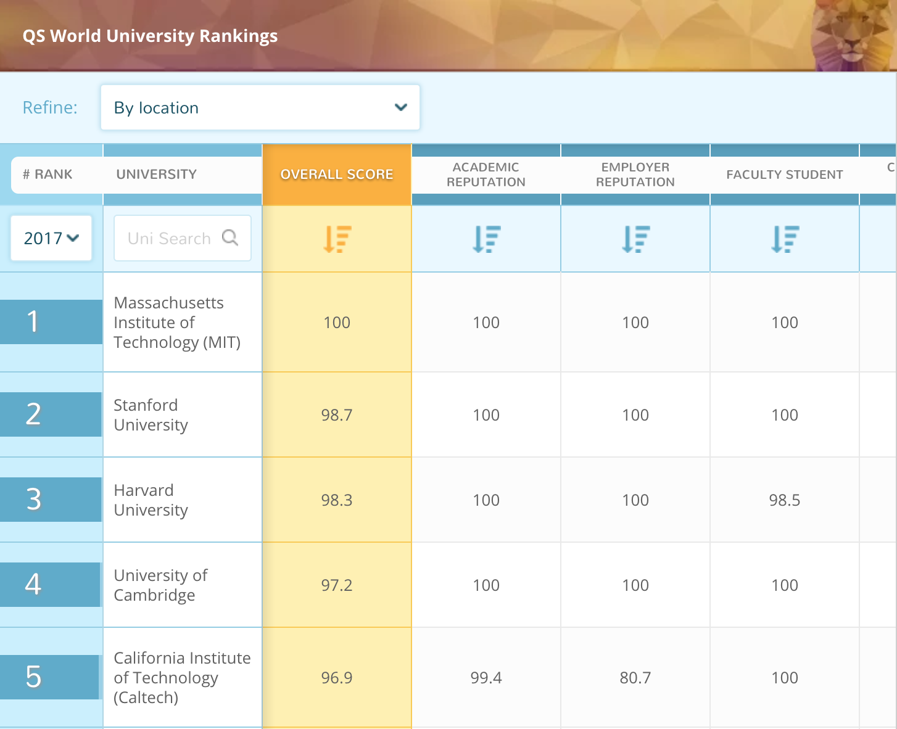
Motivation
Problems of QS World University Ranking
Pure numbers and tables
Hard to find insights besides rankings
Different subjects in different tables
Difficulty in comparison subjects for a specific school
* Image from https://www.topuniversities.com/university-rankings/world-university-rankings/2016

Slide 6
Outline
Motivation
System Design
Visualization Design
Evaluation

Slide 7








System Design
Platform
Visualization
QS World University Ranking 2017
Vue.js
D3.js
HighMaps
MySQL
Heroku
College Magnifier
Python
Wikipedia
Data Source
Framework
Data processing

Slide 8
Outline
Motivation
System Design
Visualization Design
Evaluation

Slide 9
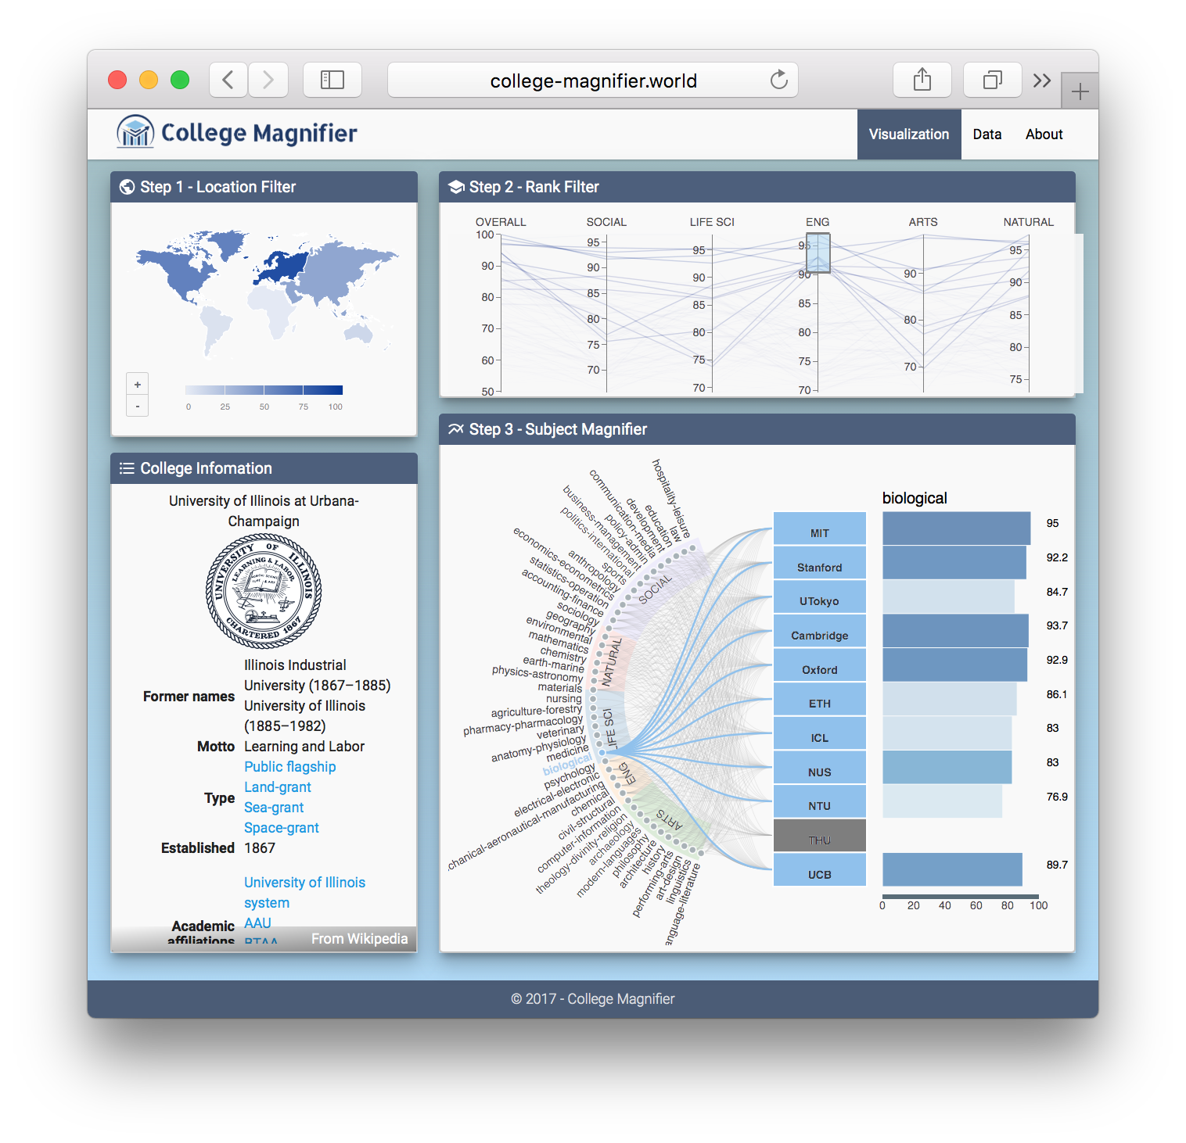
Visualization Design
The big picture
1
2
Four components:
Location Filter
Rank Filter
Subject Magnifier
College Information
3
4

Slide 10
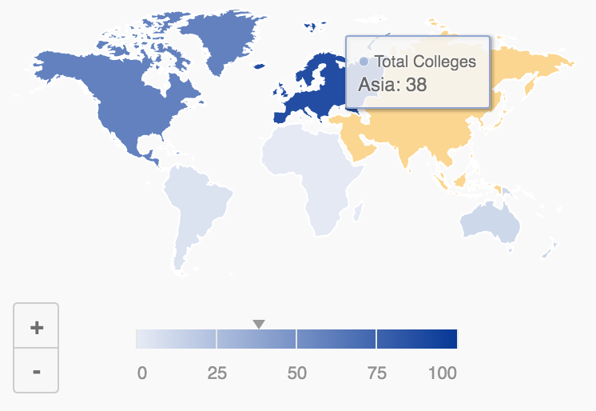
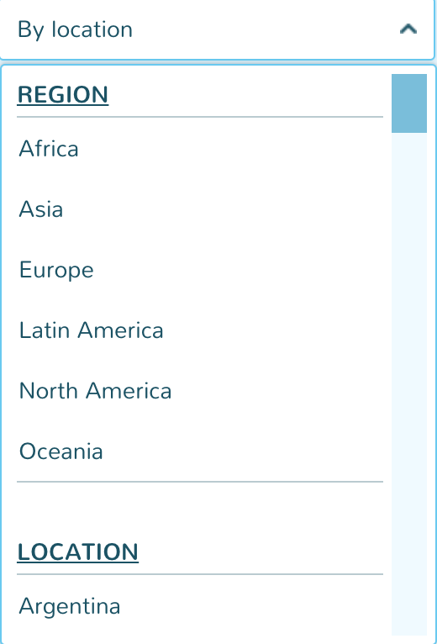
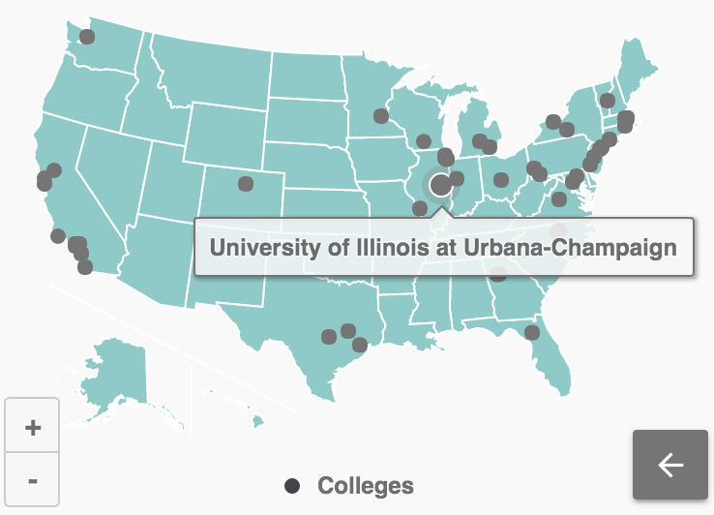
Visualization Design
Step 1 - Location Filter
Region Selection
Selector -> Maps

Slide 11
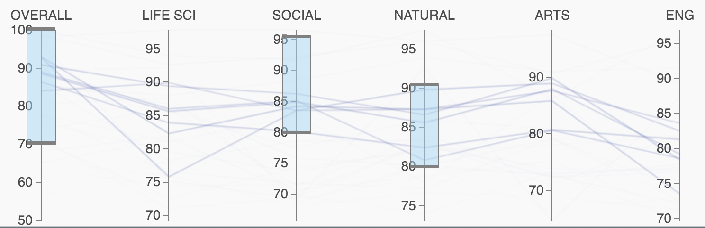
Visualization Design
Step 2 - Rank Filter
Broad Subjects Range
Range -> Parallel Coordinates

Slide 12
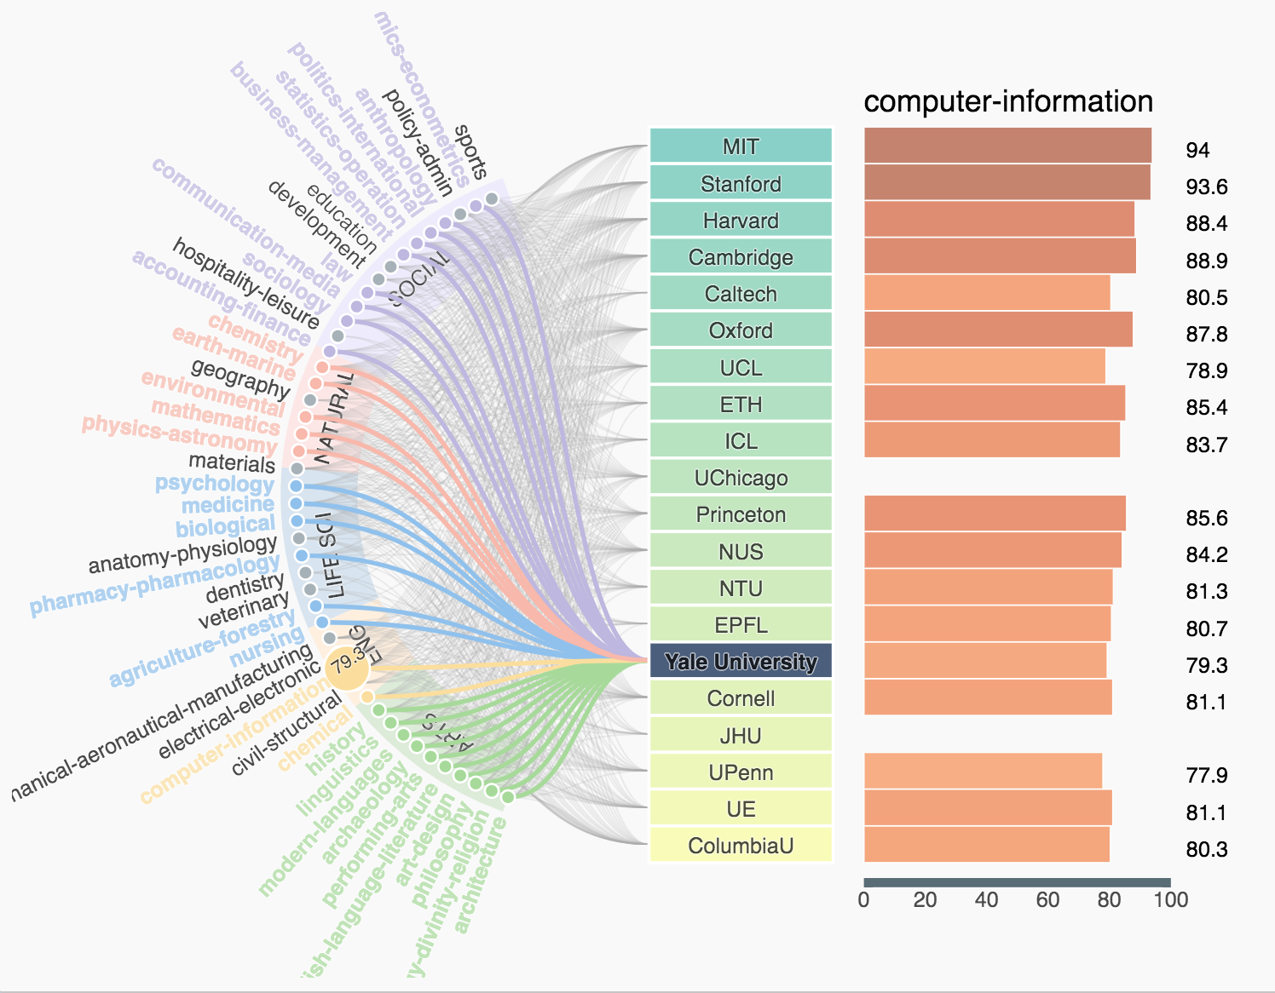
Visualization Design
Step 3 - Subject Magnifier
Specific Subjects Comparison
A designed visualization

Slide 13
Visualization Design

Slide 14
Outline
Motivation
System Design
Visualization Design
Evaluation

Slide 15
Evaluation
1. Find 5 Asian universities whose overall scores are above 80.
2. Find two universities whose Art AND Social Science scores are both above 90
3. Among all the universities overall scoring above 90, how many of them offer Computer Science and Information Management program?
4. Among those Natural Science scoring above 90, whose Psychology ranks 5th?
1. Find 5 North American universities whose overall scores are above 90.
2. Find two universities whose Engineering AND Natural Science scores are both above 90
3. Among all the universities Social Science scoring above 85, how many of them offer Education program?
4. Among those Engineering scoring above 90, whose Electrical Engineering ranks 5th?
User case study - Tasks

Slide 16
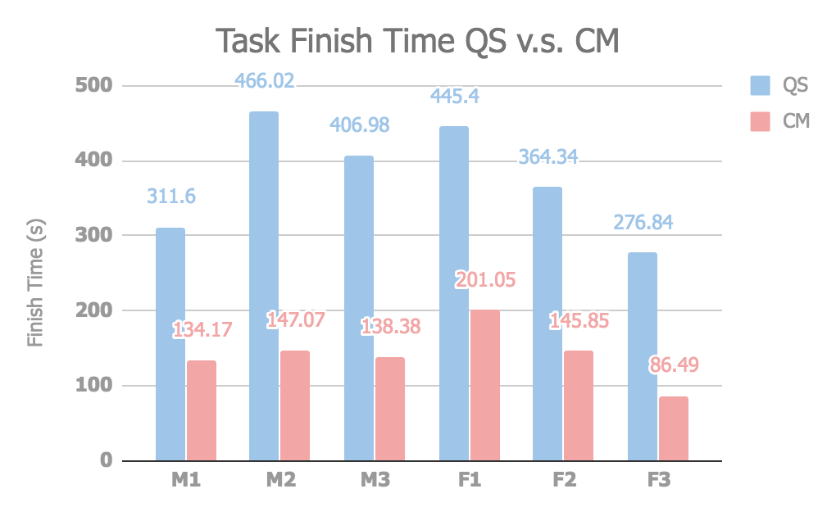
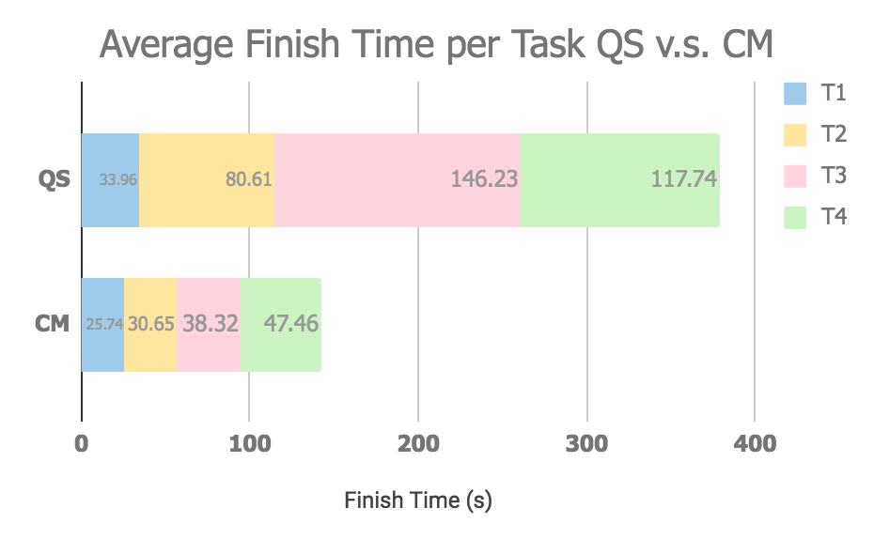
Evaluation
User case study - Result
(The smaller the better)

Slide 17
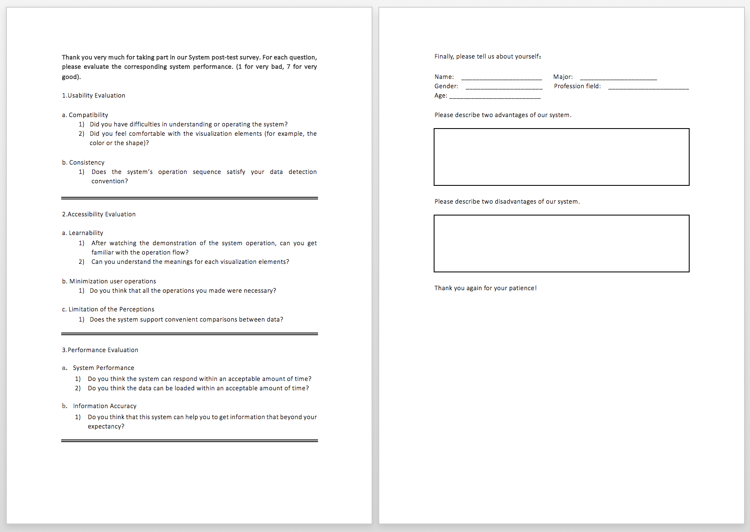
Evaluation

Slide 18



Evaluation
Easy to Understand / Operate
Comfortable w/ Visualization Elements
Satisfies Data Detection Convention
Demo Helps
Understand Meanings of Elements
All Operations are necessary
Support Convenient Comparison
Response Time Acceptable
Data Loading Time Acceptable
Get More Info Beyond Expectation

Slide 19




Evaluation
Female A
Male A
Female B
Male B
“ Region selection may not always be the best choice for me. You know… I can not find where Asia is… ”
“ The graphical UI is intuitive overall. I can easily find different subjects in a single school. ”
“ Fantastic UI! And it supports quite a lot conditional queries to some extent, which can be really helpful when comparing schools! ”
“ The step 3 may be kinda crowded when I selected range that matches more than 20 colleges. ”

Slide 20

Thank You
Website: http://www.college-magnifier.world
GitHub: https://github.com/College-Magnifier
Han Yin, Hanfei Lin, Zhuo Li
2017 © CollegeMagnifier

